Slide 1
Summary of Denver-Julesburg Basin Drill Rig 1-hr NO2 Impacts Study
Kickoff Meeting of Model
Evaluation Workgroup
John Bunyak, westar
August 14, 2015

Slide 2
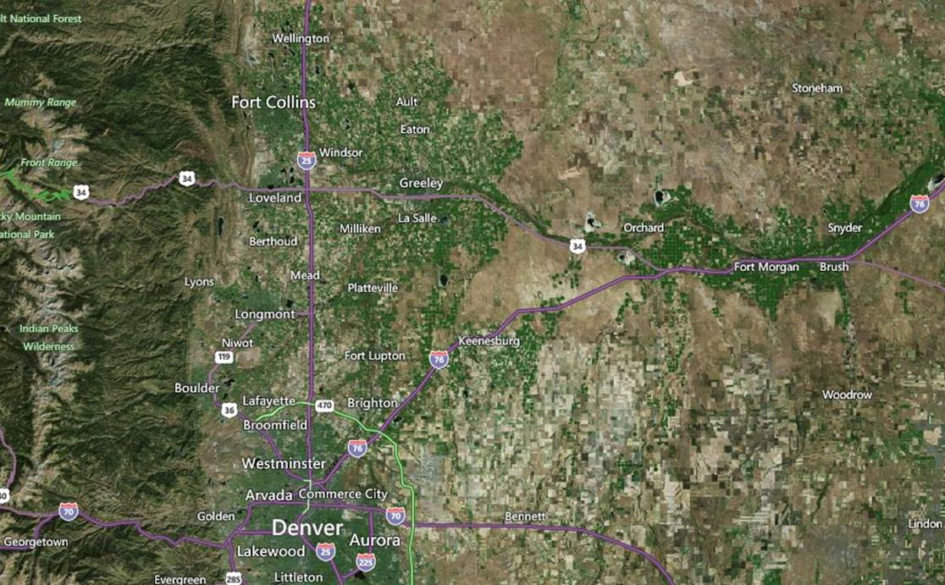
Site Location Selected for This Study: Northeast Colorado Near Platteville in Denver-Julesburg Basin (Site access provided by Anadarko Petroleum Corp.)

Slide 3
Study Purpose
To collect emissions and ambient data near drill rigs to evaluate 1-hr NO2 impacts from drilling operations
To use the emissions and ambient data to evaluate AERMOD w.r.t. drilling operations

Slide 4
Study Management
Study Management Team—Provide Direction and Guidance
Mary Uhl—BLM
Chris Owen—EPA
Darla Potter—WDEQ
Cathe Kalisz—API
Doug Blewitt—Consultant to API
WESTAR—Provide Assistance to the Study Management Team
Tom Moore—Program Director
John Bunyak—Consultant to WESTAR—Project Manager
AECOM—Contractor that conducted the field study
Amec Foster Wheeler—Contractor that performed data analysis and formatting

Slide 5
Denver-Julesburg Basin Field Study Approach
Continuously monitor NO_{x}, NO, and NO₂ emissions from the diesel engines that power a drilling rig
Continuously monitor CO₂, O₂, Temperature, and Pressure of the engine exhaust
Continuously monitor 1-hour average levels of NO and NO₂ in the near-field ambient air at 12 sites upwind, downwind, and crosswind to the drilling rig
Continuously monitor levels of O₃ in the ambient air at one upwind and downwind site
Continuously monitor wind speed and wind direction at one upwind and downwind site and on a 10-meter instrumented tower
Site 1 monitoring was conducted from October 10-26, 2014
Site 2 monitoring was conducted from November 3-16, 2014

Slide 6
Monitor Deployment
Monitors were mounted on portable trailers to facilitate moving the monitors as needed throughout the study periods
AERMOD modeling was conducted to help with the initial monitor placement
AERMOD results showed that the peak modeled NOx concentrations were located inside the drill pad
For Site 1, the monitors were positioned near the pad boundary based on predominant winds, but were not relocated due to airflow obstructions, off-pad access limitations, and power constraints
For Site 2, the monitors were repositioned based on prevailing wind forecasts

Slide 7
Site 1 Monitor Deployment
NO and NO₂ were monitored at 12 sites along the well pad perimeter
6 sites near the northwest corner of the well pad, oriented with respect to predominant daytime winds
6 sites near the southeast corner, oriented with respect to predominant nighttime winds

Slide 8
Site 1 Monitor Deployment

Slide 9
Site 2 Initial Monitor Deployment

Slide 10
Site 2 Final Monitor Deployment

Slide 11
AECOM Deliverables
All five-minute and hourly CEM, ambient pollutant, and meteorological data for both drill pads
Plot plans, including detailed site layout of the NO_{x} monitors and drill pad structures
Calibration records for ambient pollutant monitors
CEM operation logs for emission sources
Final Field Study Report and Quality Assurance Project Plan

Slide 12
AMEC Tasks
Perform Data Quality Review
Alaska data—cursory review
Colorado data—detailed review
Prepare CO data for analyses
Perform Data Analyses on CO data
Format CO data for AERMOD model evaluation
Prepare Report of work completed

Slide 13
Next Steps for Workgroup
Continue data analyses and formatting
Fill in data gaps (e.g., emissions, met., etc. (see agenda for discussion topics)
Develop a draft model evaluation protocol
Conduct Model Evaluation
Document results

